Slide 1

FindMyPet: An Android App to Reunite Pets
A Project by Lim Chanvirakyuth

Slide 2
Project Overview: Goals and Objectives
Project Name: FindMyPet
Description: A mobile application designed to create a community platform, helping reunite lost pets with their owners.
Main Goal: To provide a simple, effective way for owners to find lost pets and for finders to connect easily with owners.
Objectives:
Allow users to quickly post details and photos of a lost or found pet.
Provide a clear way to see posts about lost or found pets.
Enable direct communication between the finder and the owner.

Slide 3
The Problem & Our Solution
The Problem
Our Solution
When a pet goes missing, owners feel helpless with limited search options.
The FindMyPet app creates a centralized, easy-to-use platform.
They rely on inefficient methods like social media, posters, or word-of-mouth.
Users can quickly post about a lost pet or view posts from others who have found a pet.
This makes finding a lost pet a slow and difficult process, causing immense stress.
This consolidates information, significantly increasing the chances of a successful reunion.

Slide 4
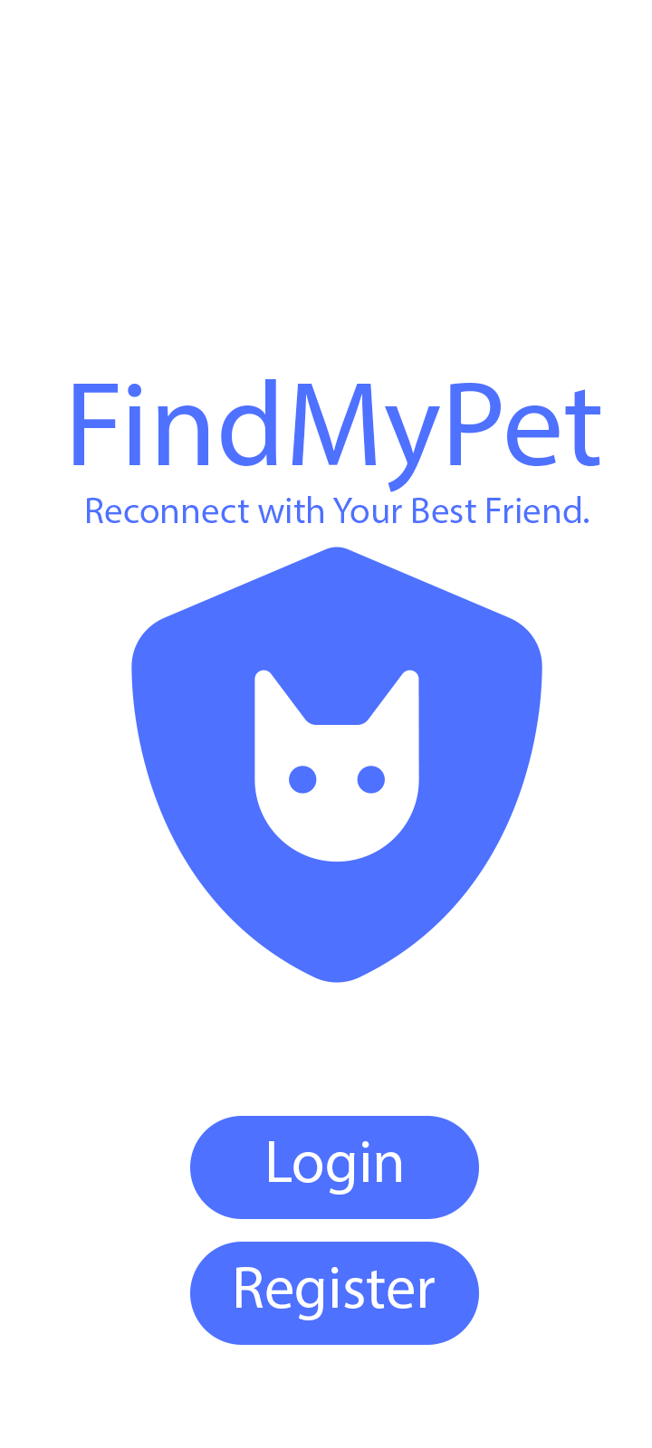
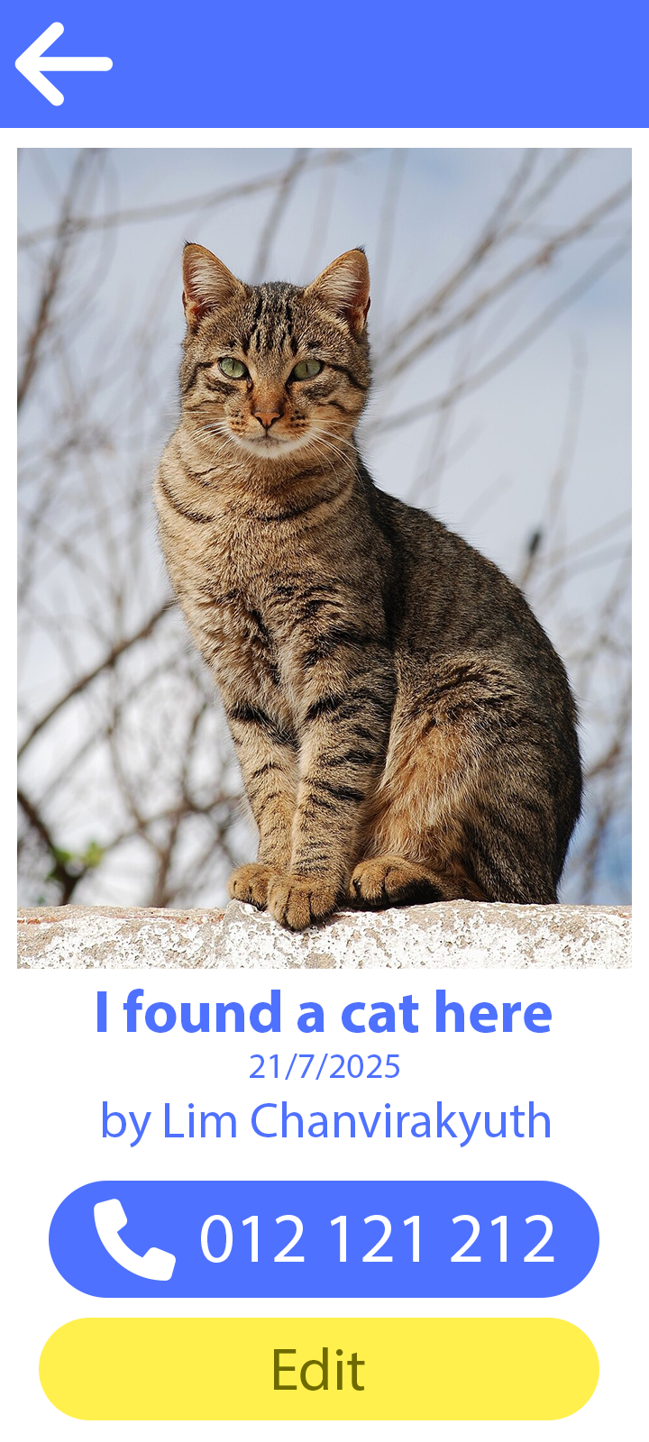
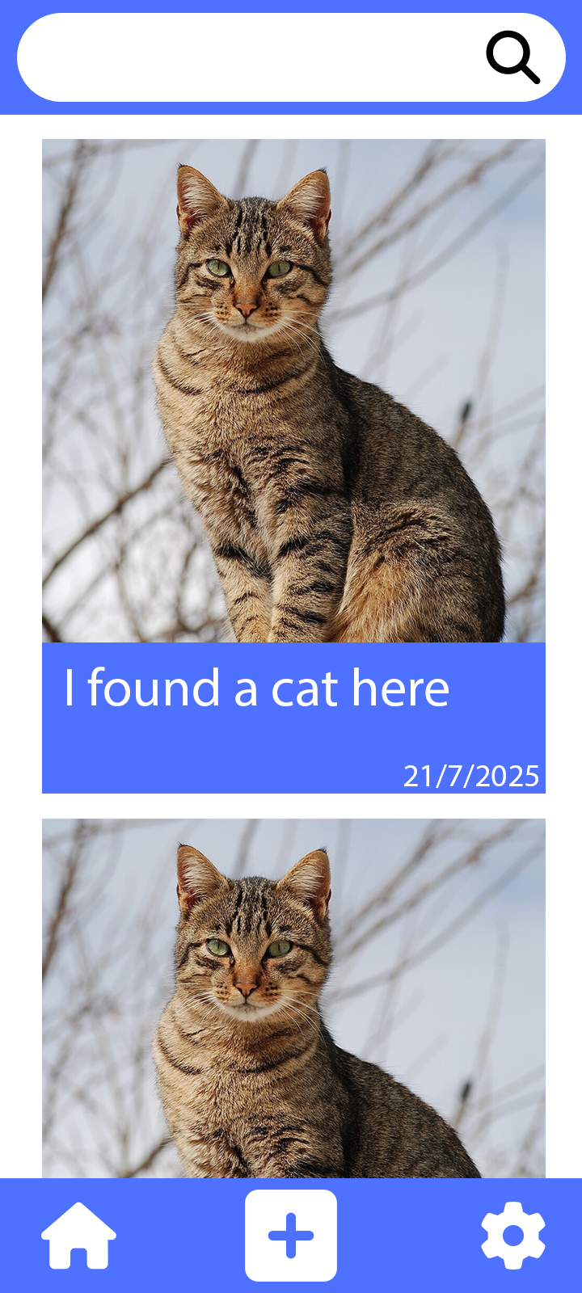
Key Features and Functionalities
Lost Pet Posts: Users can create posts with photos, descriptions, and the last known location of their lost pet.
Found Pet Posts: Individuals who find a stray pet can post pictures and details about where they found it.
Easy Contact: The app allows users to include their phone number in posts, enabling direct communication between the finder and the owner.

Slide 5

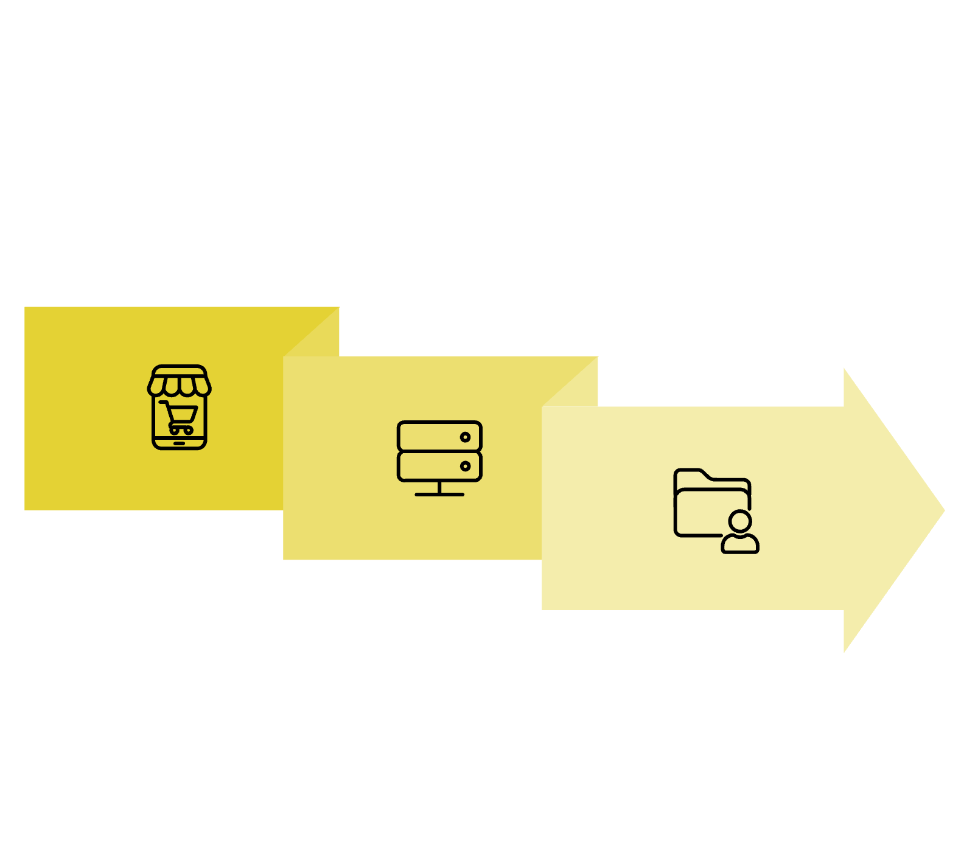





Project Architecture
Frontend
Database
Backend
The FindMyPet app's architecture includes an Android/Java frontend for user interaction, a Spring Boot backend managing authentication and posts, and a MySQL database for storing all post and user data.

Slide 6
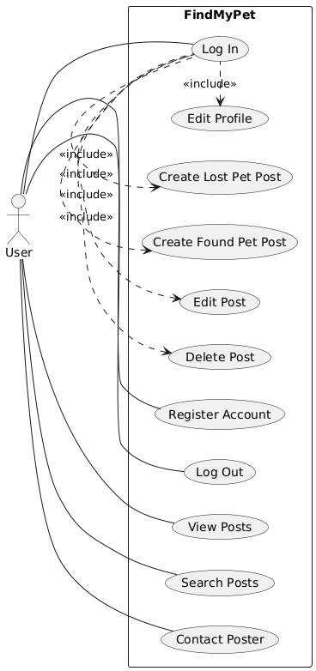
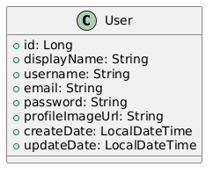
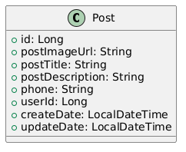
UML: Use Case Diagram & Class Diagram
Our detailed UML diagrams illustrate the app's functionalities and data relationships. The use case diagram outlines user interactions, while the class diagrams define the core entities and their connections, providing a clear blueprint for development.

Slide 7
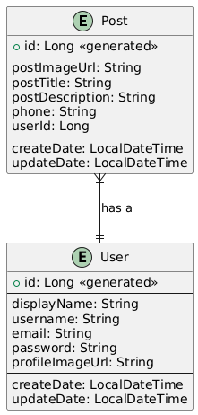
Database Design
Our detailed UML diagrams illustrate the app's functionalities and data relationships. The use case diagram outlines user interactions, while the class diagrams define the core entities and their connections, providing a clear blueprint for development.

Slide 8
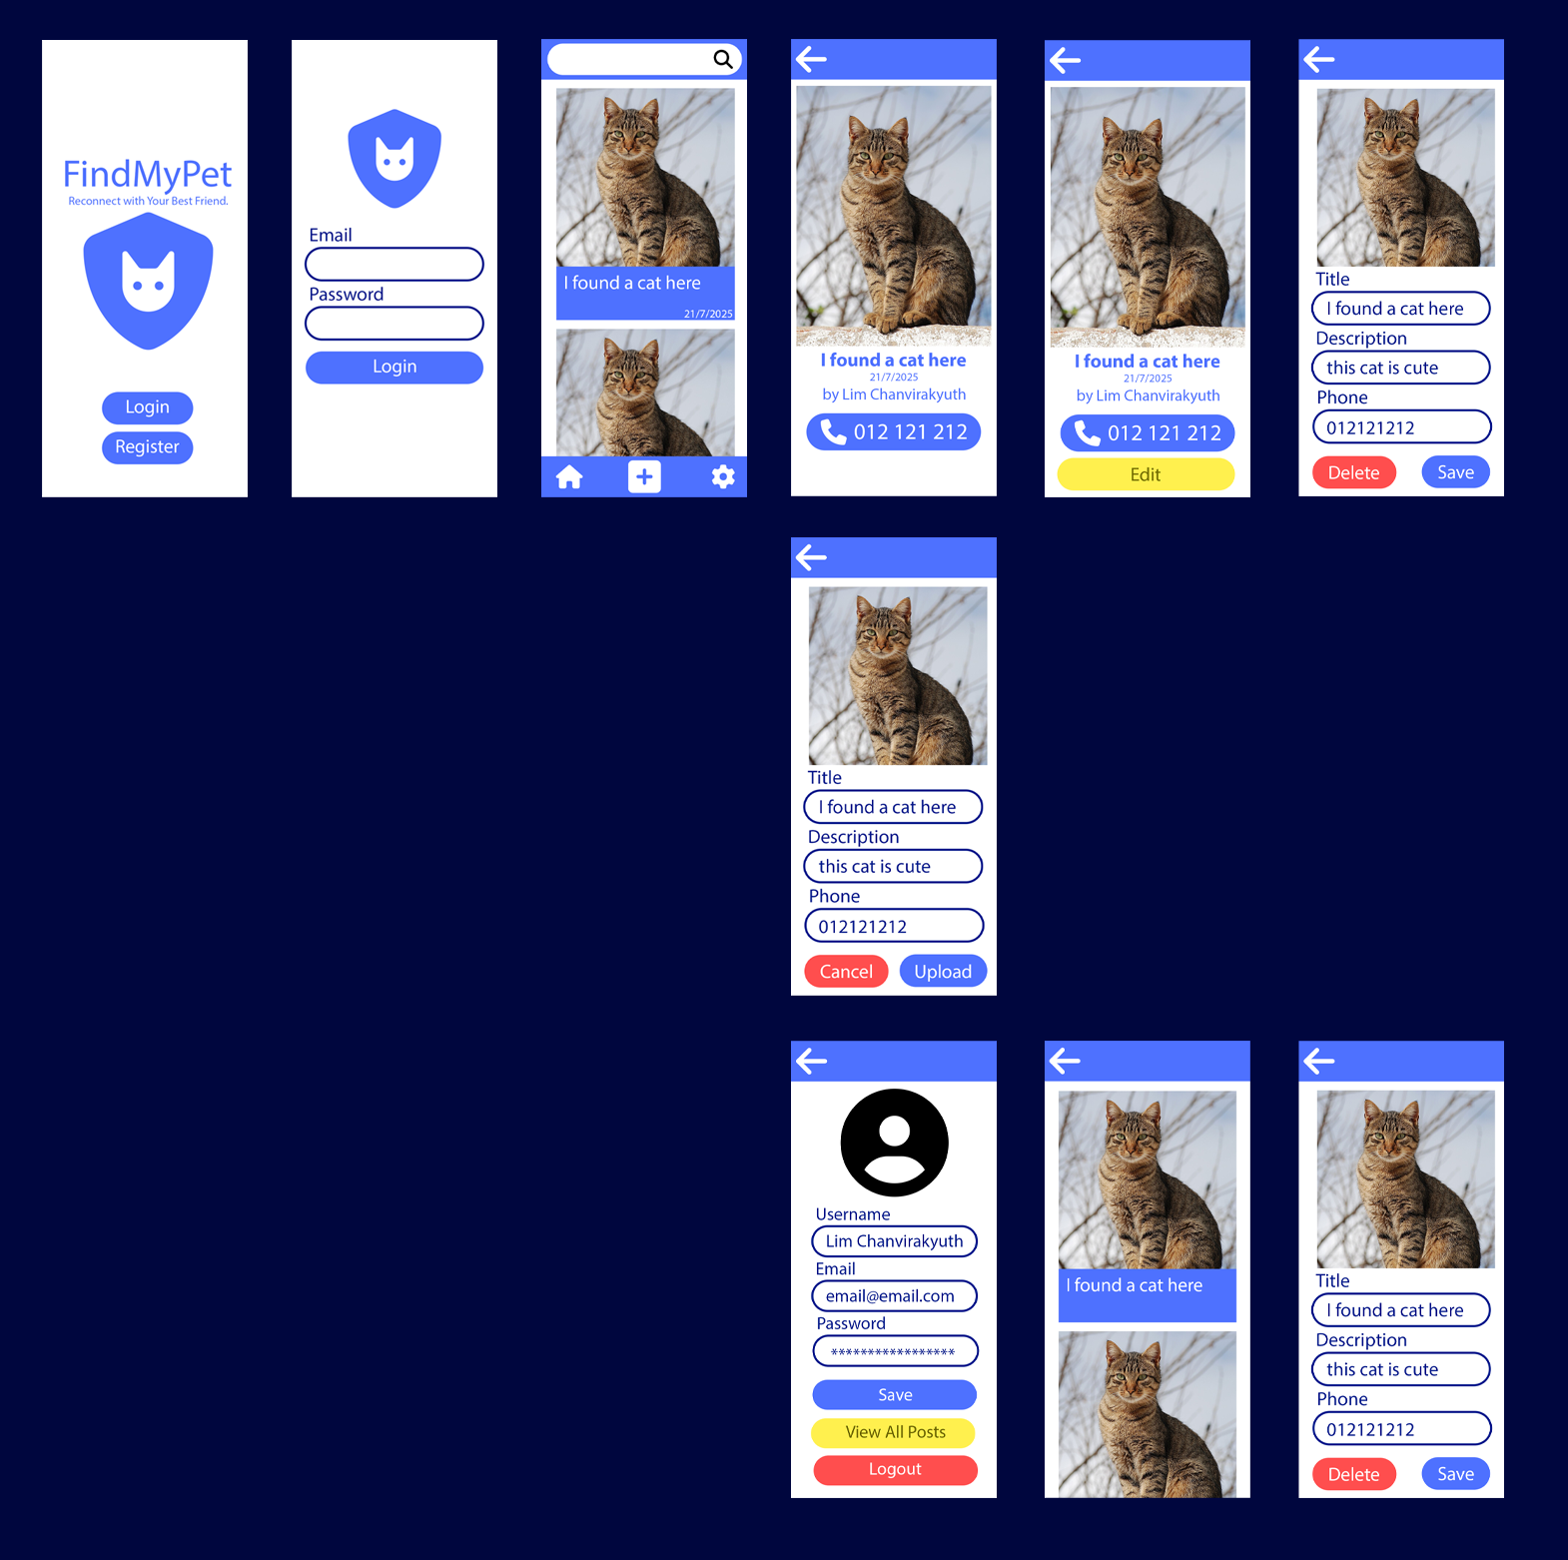
User Interface Design
The app has a simple and clear layout, making it easy for anyone to quickly post or search for pets.

Slide 9
Future Plans & Enhancements
Direct Messaging
1
Make it easier for users to communicate with each other.
Sorting and Filtering
2
Add robust filtering options (e.g., by pet type, breed, or date posted) to help users find what they are looking for more efficiently.
User Profiles
3
Allow users to view other users' profiles to see all their posted pets.
Add Location
4
Enable users to upload or search for posts by specific locations to easily find lost pets near them.

Slide 10

Thank You
FindMyPet: Reconnect with Your Best Friend.
By: Lim Chanvirakyuth

